Slide 1
Phishing Awareness Training
BY : MRIDUL KHANNA

Slide 2
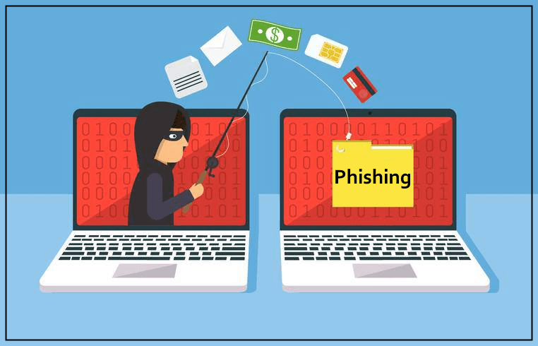
What is Phishing?
Phishing is a type of cyber attack where attackers disguise themselves as legitimate entities, typically through emails, to deceive individuals into revealing sensitive information such as passwords, credit card numbers, or personal details. These attacks aim to steal data or gain access to systems, often leading to financial loss or identity theft for the victims.

Slide 3
Why Phishing Awareness Matters
Phishing awareness is crucial for the following reasons:
1. Data Protection: Prevents unauthorized access to personal and sensitive information.
2. Financial Security: Reduces the risk of financial losses due to fraud and theft.
3. Reputation Management: Protects individuals and organizations from reputational damage.
4. Legal Compliance: Ensures adherence to data protection laws and regulations.
5. Cybersecurity Resilience: Enhances overall security posture against evolving threats.

Slide 4
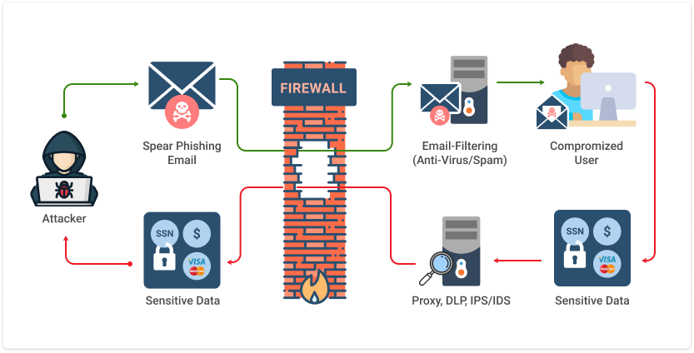
Common Phishing Techniques
Email Phishing: Attackers send fraudulent emails that appear to be from legitimate sources to trick recipients into revealing personal information.
Spear Phishing: Targeted phishing attacks directed at specific individuals or organizations, often using personalized information.
Clone Phishing: An attack where a legitimate email with an attachment or link is cloned and altered to include malicious content.
Whaling: A type of phishing targeting high-profile individuals like executives or politicians, often for significant gains.
Smishing: Phishing attempts conducted via SMS, where attackers send text messages that appear to be from trusted sources.

Slide 5
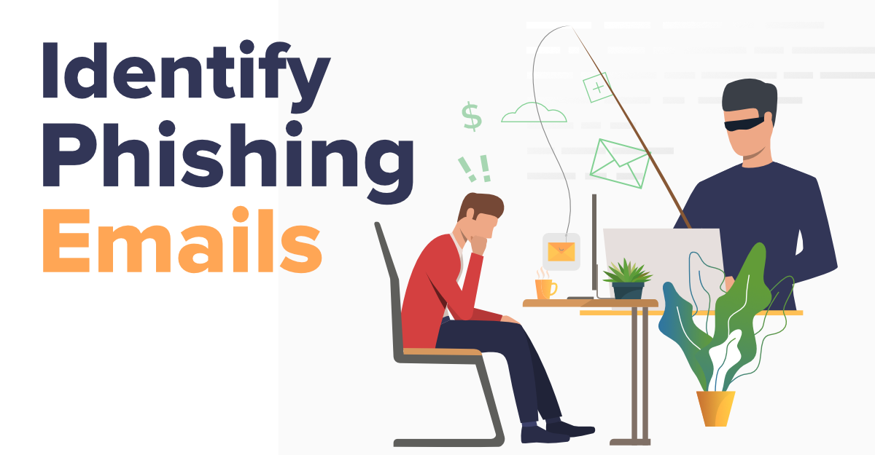
Identifying Phishing Emails
Suspicious sender email address.
- Urgent or threatening language.
- Requests for sensitive information.
- Poor grammar and spelling.
- Fake links or attachments.

Slide 6
Case Studies of Phishing Attacks
Facebook and Google
Between 2013 and 2015, Facebook and Google were tricked out of $100 million due to an extended phishing campaign. The phisher took advantage of the fact that both companies used Quanta, a Taiwan-based company, as a vendor. The attacker sent a series of fake invoices to the company that impersonated Quanta, which both Facebook and Google paid.Eventually, the scam was discovered, and Facebook and Google took action through the US legal system. The attacker was arrested and extradited from Lithuania, and, as a result of the legal proceedings, Facebook and Google were able to recover $49.7 million of the $100 million stolen from them.
Ubiquiti Networks
In 2015, Ubiquiti Networks, a computer networking company based in the US, was the victim of a BEC attack that cost the company $46.7 million (of which they expected to recover at least $15 million). The attacker impersonated the company’s CEO and lawyer and instructed the company’s Chief Accounting Officer to make a series of transfers to close a secret acquisition. Over the course of 17 days, the company made 14 wire transfers to accounts in Russia, Hungary, China, and Poland. The incident only came to Ubiquiti’s attention when it was notified by the FBI that the company’s Hong Kong bank account may have been the victim of fraud. This enabled the company to stop any future transfers and attempt to recover as much of the $46.7 million stolen as possible (which represented roughly 10% of the company’s cash position).

Slide 7
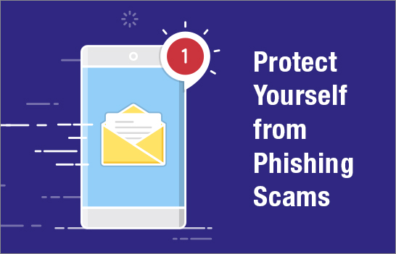
How to Protect Yourself
Do not click on suspicious links or attachments.
Verify the sender’s email address.
Use two-factor authentication.
Keep software and security measures up to date.

Slide 8
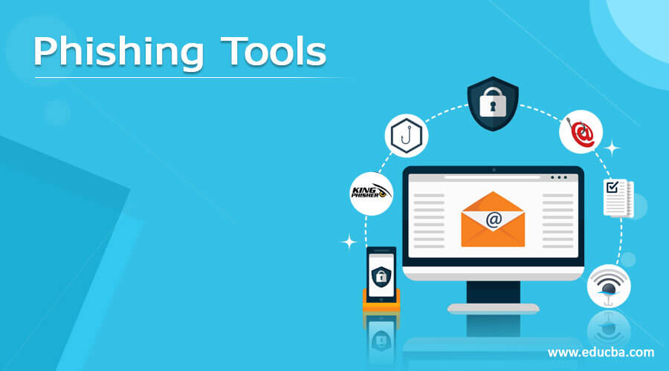
Useful Tools and Resources
PhishTank: Community-based phishing URL database for tracking and reporting phishing sites.
Mimecast: Provides comprehensive email security solutions to block phishing attacks.
Netcraft Anti-Phishing Extension: Browser extension for real-time protection against phishing sites.
StaySafeOnline by NCSA: Offers resources and tips for recognizing and avoiding phishing scams.
ReportPhishing: Platform for reporting phishing attempts and contributing to a central phishing database.

Slide 9
CONCLUSION
In conclusion, phishing remains one of the most prevalent and damaging cyber threats that can affect individuals and organizations alike. The increasing sophistication of phishing techniques highlights the importance of continual vigilance and proactive measures. By understanding the common tactics used by phishers, recognizing the warning signs of phishing attempts, and utilizing effective tools and resources, we can significantly mitigate the risks. Implementing robust security protocols, educating employees and stakeholders, and fostering a culture of cybersecurity awareness are crucial steps in defending against these attacks. Remember, staying informed and alert is our best defense against phishing and its potentially devastating consequences. Together, we can create a safer digital environment for everyone.

Slide 10
THANK YOU

